Slide 1


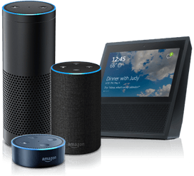
Voice Based Library Using Cloud
PREPARED BY:
JEEL SONI (16IT133)
YASTEE SHAH (16IT148)
GUIDED BY:
MR. RAVI PATEL (ASSISTANT PROFESSOR)
MR. SANDIP PATEL (ASSISTANT PROFESSOR)
SUBJECT:
SOFTWARE GROUP PROJECT – II (IT345)

Slide 2
CONTENTS
FEATURES
DEMO
REFERENCES
HOW IT WORKS
INTRODUCTION
1
2
3
4
5

Slide 3
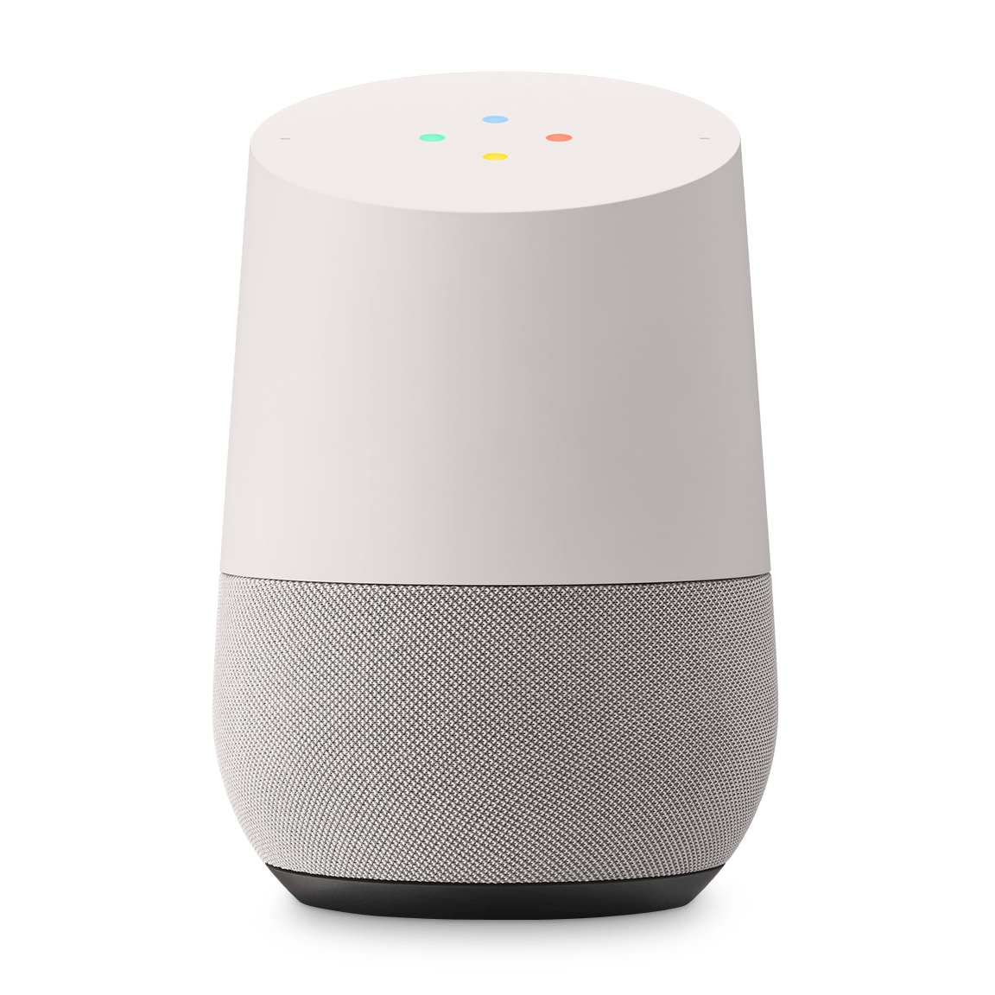
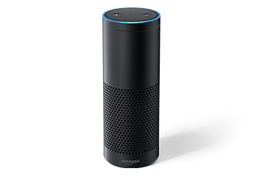
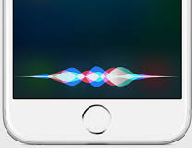

What is Voice Assistant??
Personal helper that lives in your phone, tablet, speaker, streaming box or other internet-connected device
Google Home
Amazon Alexa
Apple Siri

Slide 5
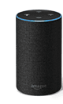
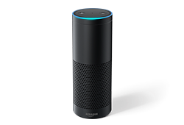
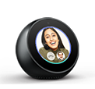
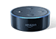

Echo Dot | Amazon Echo | Echo Plus | Echo Spot
Overview | Add Alexa to any room | Alexa-enabled smart speaker with great sound | Alexa-enabled smart speaker with built-in smart home hub | All-new stylish Echo device that can show you things
Dual speakers
Video calls to supported devices
Streaming Wi-Fi music
Connect to ext. speakers
Alexa Calling
Smart home compatible
Speaker size | 0.6" tweeter | 2.5" woofer, 0.6" tweeter | 2.5" woofer, 0.8" tweeter | 1.4" speaker
Device size | 32 x 84 x 84 mm | 148 x 88 x 88 mm | 235 x 84 x 84 mm | 104 x 96 x 91 mm
Screen size |  |  |  | 2.5"
Device weight | 163 g | 821 g | 954 g | 419 g

Slide 6

Cloud Service Provider

Slide 7




AWS LAMBDA
AWS DYNAMODB
AWS IAM

Slide 8
HOW IT WORKS…
Alexa Skill Kit
Lambda function
DynamoDB database tables

Slide 9

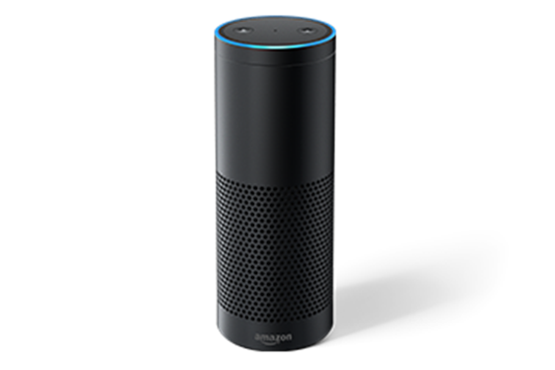


+

Slide 10
Alexa Skill Kit
Invocation model
Intents, Samples and Slots
Endpoint
Alexa skill kit

Slide 11
DynamoDB database tables
Book Records
BookName
AuthorName
Student Registration
StudentID
LibraryCard ID
Issued books
AuthorName
Available Books
BookName
IssuedDate
DueDate
LibraryCardID
StudentID

Slide 12
Lambda Function

Slide 13
Features Of Voice Based Library
Voice based library
Ask for particular Book
Check the avability from any place
Check the due date
Check avability date of book if copy not present at moment
Book the copy for you if available
Suggests reference book asked by user based on author or the subject
Search book based on the subject or author

Slide 14
DEMO

Slide 15
References
https://docs.aws.amazon.com/amazondynamodb/latest/developerguide/GettingStarted.NodeJs.04.html
https://medium.com/@sjur/using-voice-commands-to-control-a-website-with-amazon-echo-alexa-part-3-6-e8a3b8254191
https://stackoverflow.com/questions/48882632/read-data-from-dynamodb-and-recall-with-alexa
https://hackernoon.com/my-alexa-skill-with-storage-5adb1d097b88
https://codeburst.io/how-to-create-an-alexa-skill-with-node-js-and-dynamodb-3c9d5e9661

Slide 16

Any Queries

